Slide 1
SENTIMENT ANALYSIS USING HADOOP FRAMEWORK AND DEEP LEARNING ALGORITHM
Team Details
1. K. Sowmya(20EG105416)
2. K. Chandu(20EG105422)
3. N. Harsha Vardhan Reddy(20EG105451)
Project Supervisor
Dr. P. Rathna Sekhar
Assistant Professor
Department of CSE

Slide 2
Introduction
Sentiment analysis, a crucial task in natural language processing (NLP), plays a pivotal role in understanding and extracting sentiments and opinions from textual data. With the exponential growth of online content across social media platforms, e-commerce websites, and customer reviews, the demand for real-time sentiment analysis solutions has surged. Real-time sentiment analysis enables businesses to swiftly respond to customer feedback, monitor brand perception, and gauge market trends, thus gaining a competitive edge in today's dynamic landscape.
Traditional sentiment analysis approaches often face challenges in processing large-scale, real-time data due to their computational overhead and scalability limitations. To address these challenges, emerging technologies such as Hadoop and Apache Spark have garnered attention for their distributed computing capabilities, enabling the processing of massive datasets in parallel. Additionally, deep learning algorithms, particularly Recurrent Neural Networks (RNN) and Convolutional Neural Networks (CNN) , have demonstrated remarkable performance in sentiment analysis tasks by automatically learning hierarchical representations of text.

Slide 3
Introduction
Benefits:
Scalability
Efficiency
Accuracy
Flexibility and Adaptability
Applications:
Customer service
Social media monitoring
Financial markets
Healthcare

Slide 4
Problem Statement
The problem statement aims to evaluate and compare the performance of real-time sentiment analysis frameworks utilizing Hadoop, Apache Spark, and deep learning algorithms such as Recurrent Neural Networks (RNN). The study seeks to assess the scalability, efficiency, and accuracy of these frameworks in handling real-time sentiment analysis tasks, with the objective of providing insights into their strengths and limitations for practitioners seeking to deploy such systems in various applications.
Existing method:
The current landscape of real-time sentiment analysis systems predominantly relies on traditional approaches and standalone frameworks. These systems often employ batch processing techniques for sentiment analysis tasks and lack the scalability and efficiency required to handle large-scale, real-time data streams effectively. Typically, sentiment analysis in these systems involves preprocessing textual data, extracting features, and applying machine learning algorithms for sentiment classification. However, due to the inherent limitations of batch processing and single-node architectures, the systems encounter several disadvantages like lack of real-time processing, limited efficiency, complexity in deployment and maintenance.

Slide 5
Proposed Method
Performing real-time sentiment analysis using the Hadoop framework and deep learning involves several steps.
Data Collection: Gathering real-time data from various sources such as social media, news feeds, or any other relevant platforms. This data will contain text that needs to be analyzed for sentiment.
Data Pre-processing: This involves tasks like removing special characters, tokenizing the text into words, removing stop words, and stemming or lemmatizing words.
Hadoop Setup: Setting up a Hadoop cluster for distributed processing. Hadoop provides a distributed file system (HDFS) and MapReduce framework, which can be used for distributed storage and processing of large datasets.
Deep Learning Model: Training a deep learning model for sentiment analysis. This involves using frameworks like TensorFlow to build and train a deep learning model such as a recurrent neural network (RNN) for sentiment analysis.
Integration with Hadoop: Integrate the deep learning model with Hadoop for real-time analysis. This can be done using tools like Apache Spark, which provides APIs for running computations on large datasets in a distributed manner.
Real-Time Analysis: As new data arrives, it can be processed and analyzed in parallel across the nodes of the Hadoop cluster using the deep learning model.
Visualization: Visualizing the results of the sentiment analysis and generating reports as needed.

Slide 6
Experiment Requirements
1. Hadoop: The project requires installation and configuration of the Hadoop distributed computing framework to facilitate distributed storage and processing of large-scale data.
2. Apache Spark: Apache Spark needs to be installed to leverage its in-memory data processing capabilities for efficient data manipulation and feature extraction.
3. Deep Learning Framework: A deep learning framework such as TensorFlow or PyTorch is required for implementing Recurrent Neural Networks (RNNs) for sentiment analysis.
4. Python Libraries: Various Python libraries such as Pandas, NumPy, NLTK (Natural Language Toolkit), and Scikit-learn may be necessary for data preprocessing, feature extraction, and model evaluation.

Slide 7

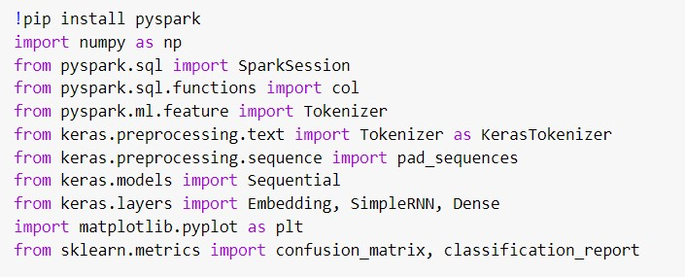
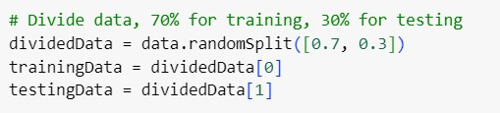
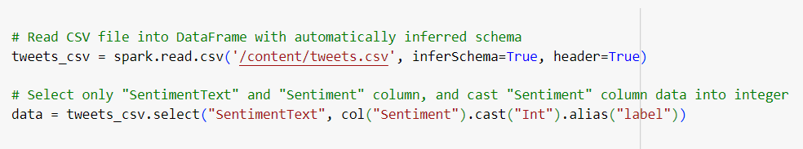
Experiment Screen shorts
1.Importing necessary libraries
2.Starting a spark session
4. Dividing the data into training and testing data
3. Reading the dataset

Slide 8
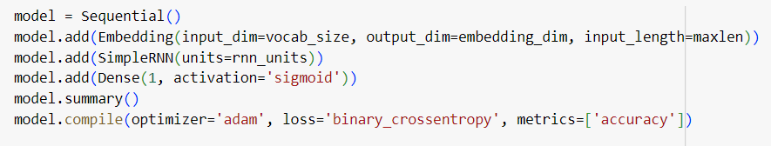

Experiment Screenshots
5. Embedding RNN
6. Training the model
7. Generating the classification report

Slide 9
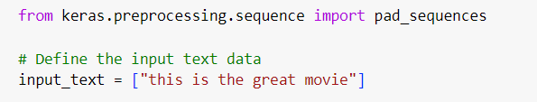
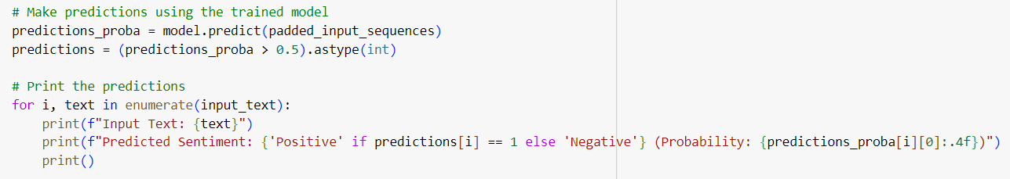
Experiment Screen shots
8. Predicting the sentiment

Slide 10
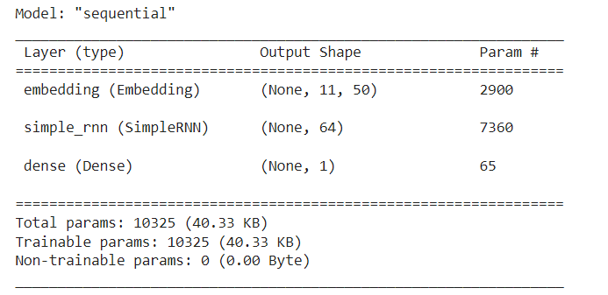
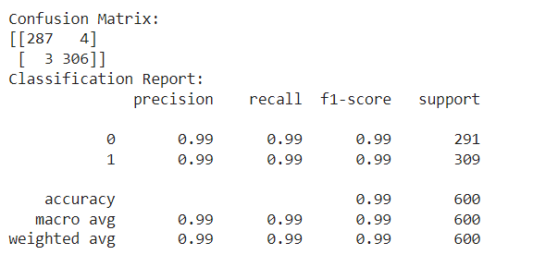
Experiment Results
Model summary
Classification report

Slide 11
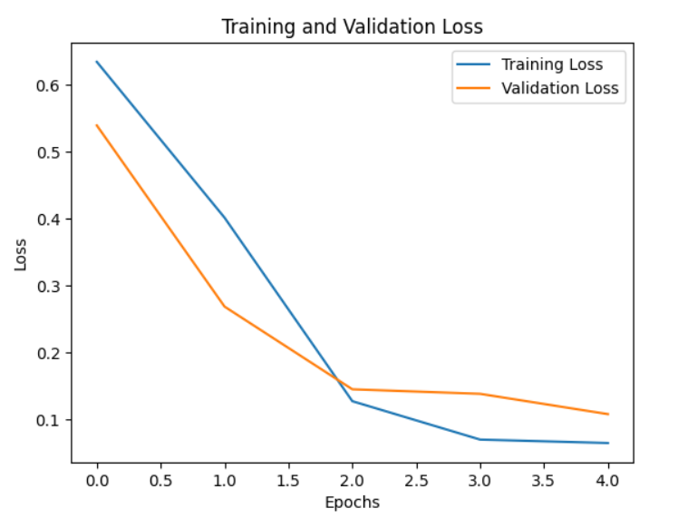
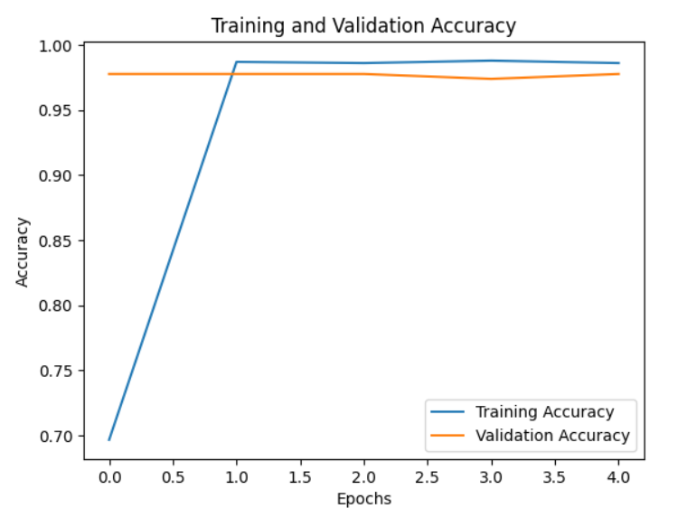
Experiment Results
Training and validation scores for Loss and Accuracy

Slide 12
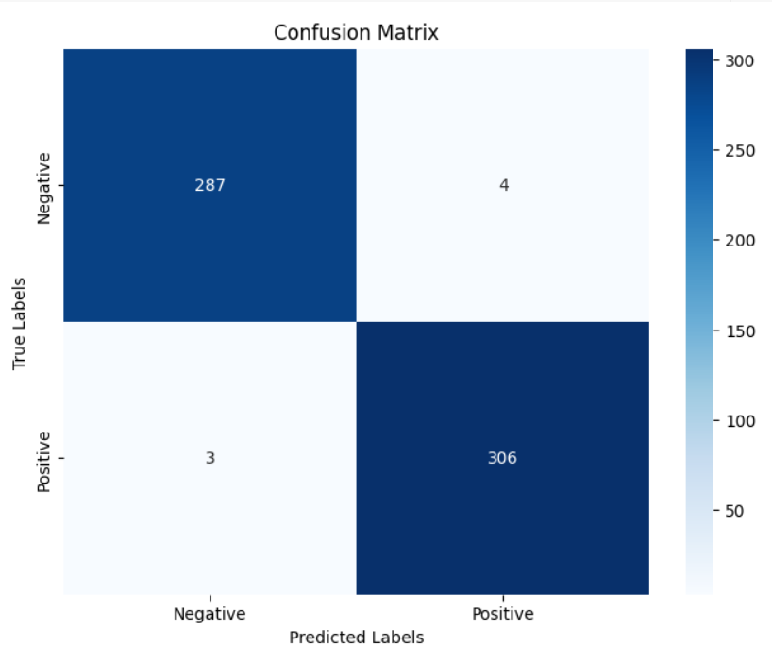




Experiment Results
Reporting the results
Confusion matrix
Positive sentiment:
Negative sentiment:

Slide 13
Findings
The proposed method is able to predict the sentiment accurately.
Apache spark has better scalability than Hadoop map-reduce especially for the real-time sentiment analysis.
Apache spark utilizes resources more efficiently providing better performance.
By utilizing deep learning technique, sentiment analysis with Hadoop achieved higher accuracy in classifying sentiment as positive and negative.

Slide 14
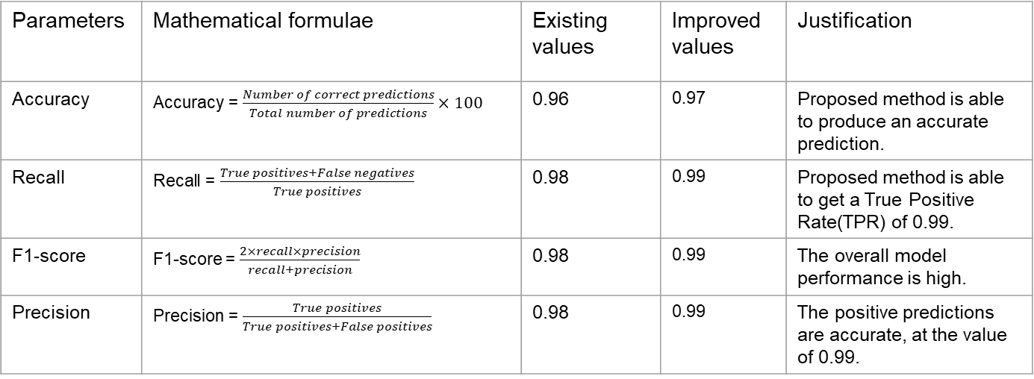
Justification
Parameters | Mathematical formulae | Existing values | Improved values | Justification
Accuracy | Accuracy = $\frac{Number of correct predictions}{Total number of predictions}×100$ | 0.96 | 0.97 | Proposed method is able to produce an accurate prediction.
Recall | Recall = $\frac{True positives+False negatives}{True positives}$ | 0.98 | 0.99 | Proposed method is able to get a True Positive Rate(TPR) of 0.99.
F1-score | F1-score = $\frac{2×recall×precision}{recall+precision}$ | 0.98 | 0.99 | The overall model performance is high.
Precision | Precision = $\frac{True positives}{True positives+False positives}$ | 0.98 | 0.99 | The positive predictions are accurate, at the value of 0.99.

Slide 15
Thank you

